Slide 1



Cost-effectiveness analysis of the helicopter emergency medical services for stroke patients in Austria, best value for money
Evelyn Walterª, Christian Helmenstein^{b}, Martin Gleitsmann^{c}, Harald Schitnig^{c}
ªIPF Institute for Pharmaeconomic Research, Vienna, Austria
^{b}Economica Institute; Federation of Austrian Industries, both Vienna, Austria; Seeburg Castle University, Seekirchen, Austria
^{c}Economica Institute, Vienna, Austria

Slide 2

CONFLICT OF INTEREST STATEMENT
The authors have no financial relationships to disclose or conflicts of interest (COIs) to resolve relating to the lecture.
IPF - Institut für Pharmaökonomische Forschung
2

Slide 3
Background
In general, health economic evaluation provide information to decision makers for efficient use of available resources for maximizing health benefits.
From a health economics perspective, the economic assessment of helicopter emergency medical services (HEMS) is a highly interesting issue. The reasons are manifold:
  A time delay in hospital admission in acute events is associated with a high disease burden and subsequent costs:
  Burden of disease is defined as: premature death, morbidity and disability, as well as direct medical and nursing costs.
  The literature documented highly cost-effective results ranging from $3,292 to $2,227 per year of life gained for trauma patients and $3,258 per year of life gained for non-trauma patients ($7,138 and $12,022 per quality-adjusted year of life gained).¹
  Costs for transportation arise today but the benefit occurs in the future.
¹Taylor CB, Stevenson M, Jan S, Middleton PM, Fitzharris M, Myburgh JA. A systematic review of the costs and benefits of helicopter emergency medical services. Injury. 2010 Jan;41(1):10-20. doi: 10.1016/j.injury.2009.09.030. PMID: 19853251.
IPF - Institut für Pharmaökonomische Forschung
IPF - Institut für Pharmaökonomische Forschung
3
3

Slide 4
Aim of the analysis
The aim of this study was to evaluate the cost-effectiveness of a HEMS (≤ 90 Min) compared with ground-based ambulance-transport for patients with acute stroke to a stroke unit (SU).
  Determination of the resource allocation and medical costs including nursing costs as a clinical consequence of the stroke diagnosis
  Determination of transport costs
  Improvement of patient outcomes expressed in a better modified Ranking Scale (mRS) state, higher life-expectancy and higher quality adjusted life-years (QALYs).
  Financial impact as a result of a higher percentage of SU admissions carried out by HEMS
IPF - Institut für Pharmaökonomische Forschung
IPF - Institut für Pharmaökonomische Forschung
IPF - Institut für Pharmaökonomische Forschung
4
4
4

Slide 5
Methodological approach
The health economic model compared 2 alternatives:
Costs and benefits will be compared over a time horizon of 10 years.
The target population (≈ 13,000) of the analysis includes patients who were admitted in a SU for at least one day (54% of all stroke patients).
It is assumed that a HEMS primarily approached one of the 38 SU in Austria.
When hospitalized, 60% of all strokes are classified as mild (NIH-SS > 0 and < 6), 22% as moderate (NIH-SS 6 to 13), and 18% as severe (NIH-SS > 13).
Outcome data according to mRS are based on the Austrian Stroke Registry.¹
¹Schellen C, Posekany A, Ferrari J, Krebs S, Lang W, Brainin M, Staykov D, Sykora M; Austrian Stroke Unit Registry Collaborators. Temporal trends in intracerebral hemorrhage: Evidence from the Austrian Stroke Unit Registry. PLoS One. 2019 Nov 20;14(11):e0225378.
IPF - Institut für Pharmaökonomische Forschung
IPF - Institut für Pharmaökonomische Forschung
IPF - Institut für Pharmaökonomische Forschung
5
5
5

Slide 6
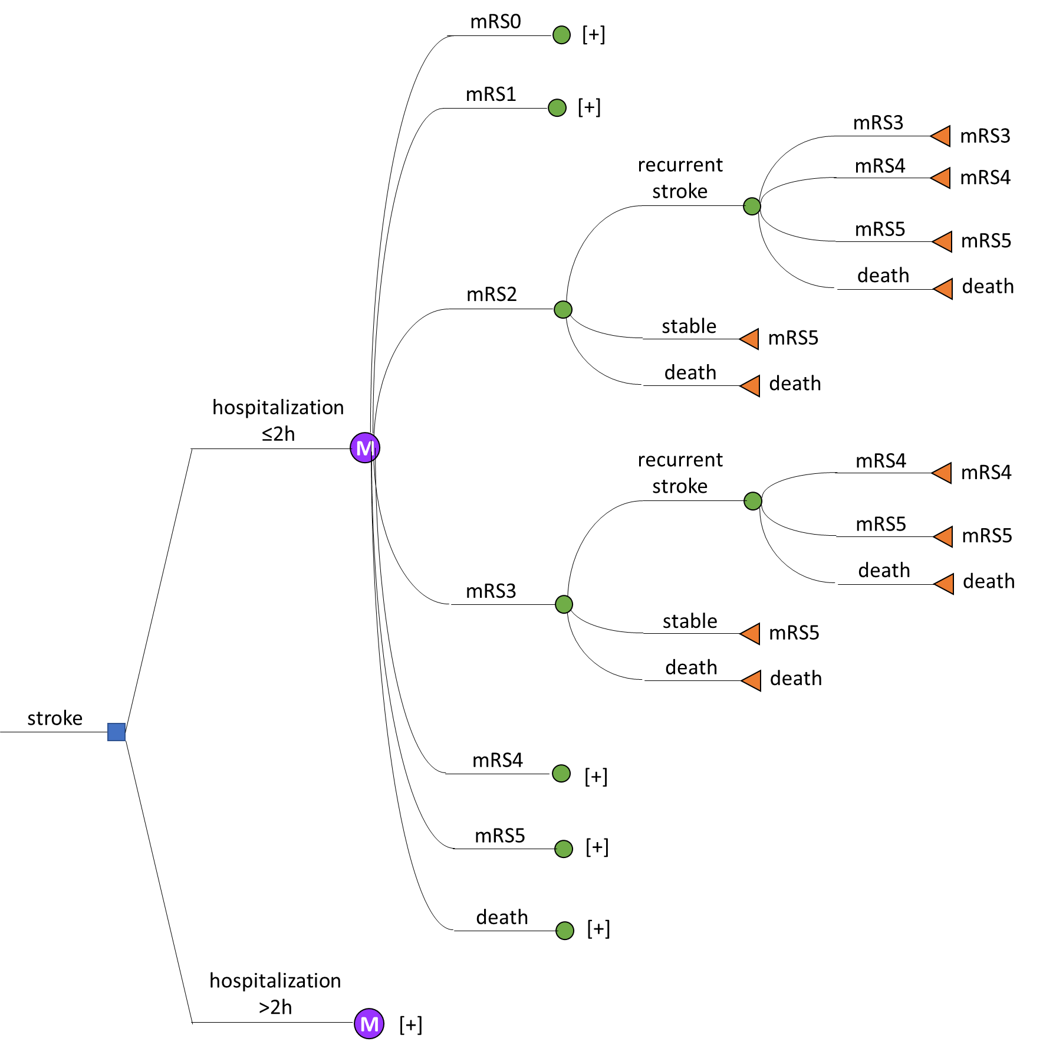
The model
Model Design
The definition of health states were based on the clinical data of the mRS after 90 days.
The treatment effect associated with the time of therapy start, influenced by the duration until hospital admission, was considered in the form of odds ratios (OR).¹
Information on future events, such as recurrent strokes and mortality, was integrated based on the literature describing long-term follow-ups.²
¹Aichner F, Topakian R. Thrombolyse bei akutem ischämischem Schlaganfall. J KARDIOL 2003; 10 (Suppl E)
² Tung CE, Win SS, Lansberg MG. Cost-effectiveness of tissue plasminogen acti-vator in the 3 to 4.5 hour time-window for acute ischemic stroke. Stroke. 2011 Aug; 42(8): 2257–2262.
[+] indicates that the subtree is not completely displayed. The content of the subtrees are the same as in the subtree above.
IPF - Institut für Pharmaökonomische Forschung
IPF - Institut für Pharmaökonomische Forschung
IPF - Institut für Pharmaökonomische Forschung
6
6
6

Slide 7
Medical Costs
The resource consumption was assessed using retrospective data and data from the literature.
Costs represent data from the year 2020.
Direct costs include:
  First and recurrent stroke costs (include cost of thrombolysis with rt-PA as well as the intervention costs of mechanical thrombectomy and ICU costs).
  Transportation costs
  Monitoring costs
  Rehabilitation costs
  Nursing home costs
  Care allowance costs
IPF - Institut für Pharmaökonomische Forschung
IPF - Institut für Pharmaökonomische Forschung
IPF - Institut für Pharmaökonomische Forschung
7
7
7

Slide 8
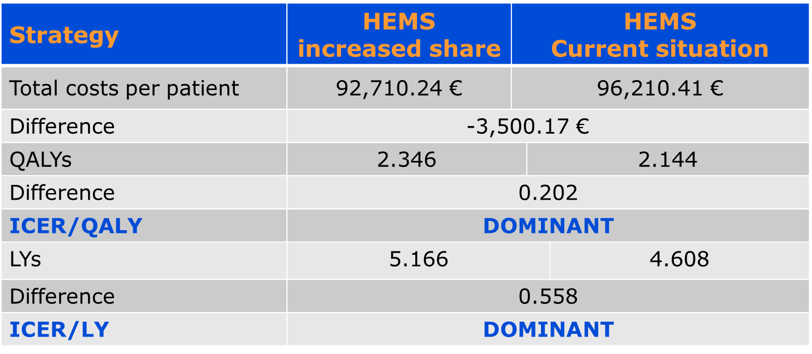
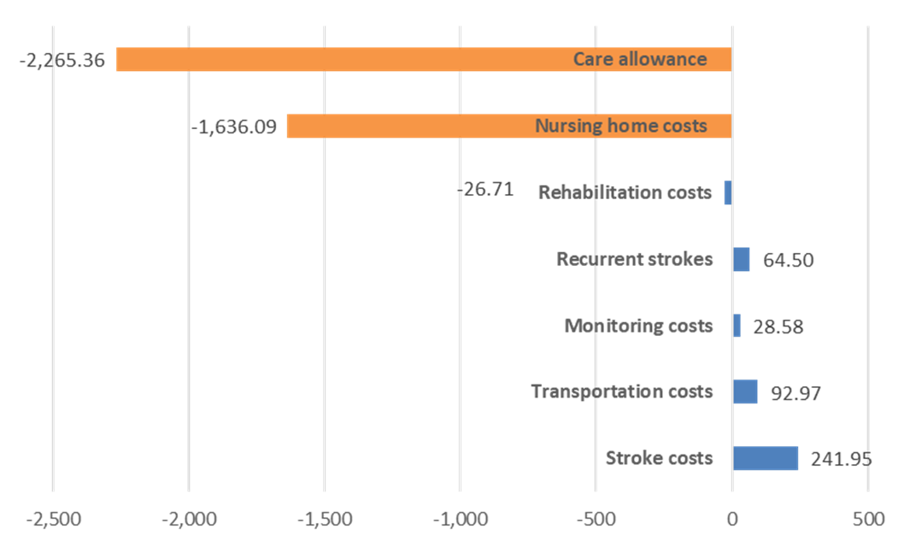
Results (1)
(1) Increased share of deliveries by HEMS (20%) vs. current situation (4.9%)
The average total cost per patient, with an increased share of HEMS, is 92,710 € over 10 years, compared to per patient costs in the current situation of 96,210 €.
An increased percentage of HEMS dominates the current situation.
The average costs of stroke treatment are higher with an increased proportion of HEMS, but are compensated by savings in rehabilitation, nursing home and care allowance costs.
Base case results of scenario (1)
Additional costs and savings of scenario (1)
Source: own calculations
IPF - Institut für Pharmaökonomische Forschung
IPF - Institut für Pharmaökonomische Forschung
IPF - Institut für Pharmaökonomische Forschung
8
8
8

Slide 9
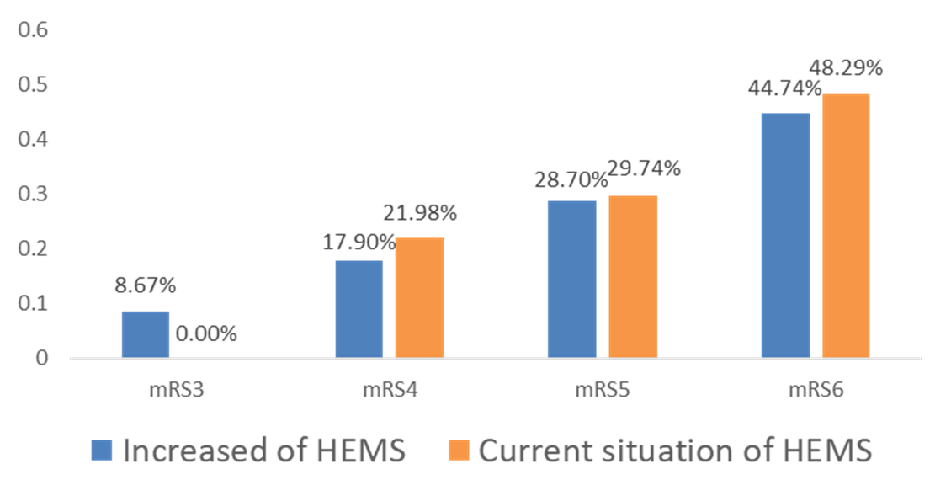
Results (2)
(1) Increased share of deliveries by HEMS (20%) vs. current situation (4.9%)
An increased proportion of HEMS also achieved a better outcome.
In year 10, more patients remained in better health stages according mRS than in the comparator group.
A higher frequency of HEMS generated additional 0.202 QALYs or 2.4 months in perfect health.
A higher proportion of HEMS improved life expectancy by 0.558 LYs or 6.7 months.
mRS distribution in year 10 of scenario (1)
IPF - Institut für Pharmaökonomische Forschung
IPF - Institut für Pharmaökonomische Forschung
IPF - Institut für Pharmaökonomische Forschung
9
9
9

Slide 10
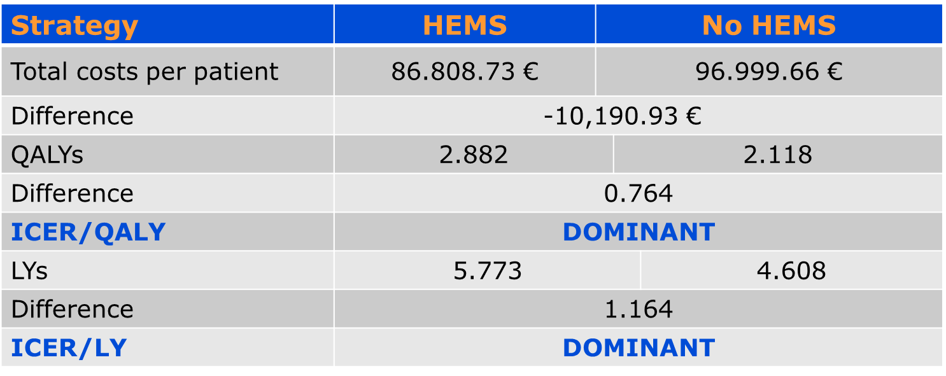
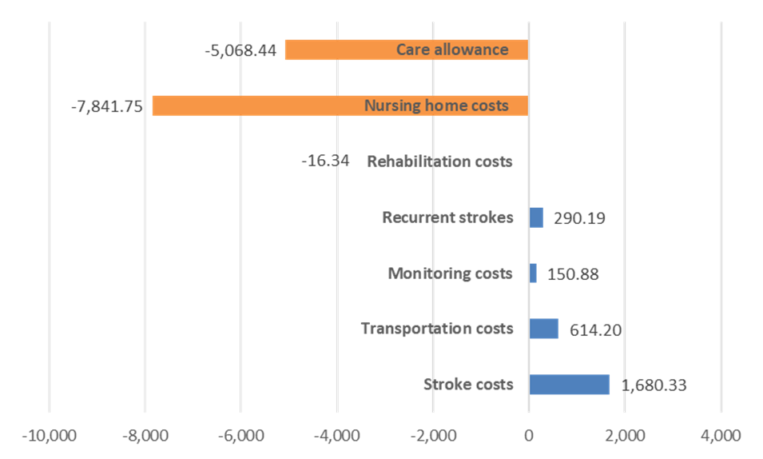
Results (3)
(2) Patient delivered with HEMS vs. patient delivered with ambulance-transport
When a HEMS is compared with a ground-based ambulance-transport the cost advantage increases significantly to -10,191 €. The comparison showed again a dominant result.
HEMS dominates the ground-based ambulance-transport.
Cost savings are generated in the same cost components, but on a larger scale.
Base case results of scenario (2)
Additional costs and savings of scenario (2)
Source: own calculations
IPF - Institut für Pharmaökonomische Forschung
IPF - Institut für Pharmaökonomische Forschung
IPF - Institut für Pharmaökonomische Forschung
10
10
10

Slide 11
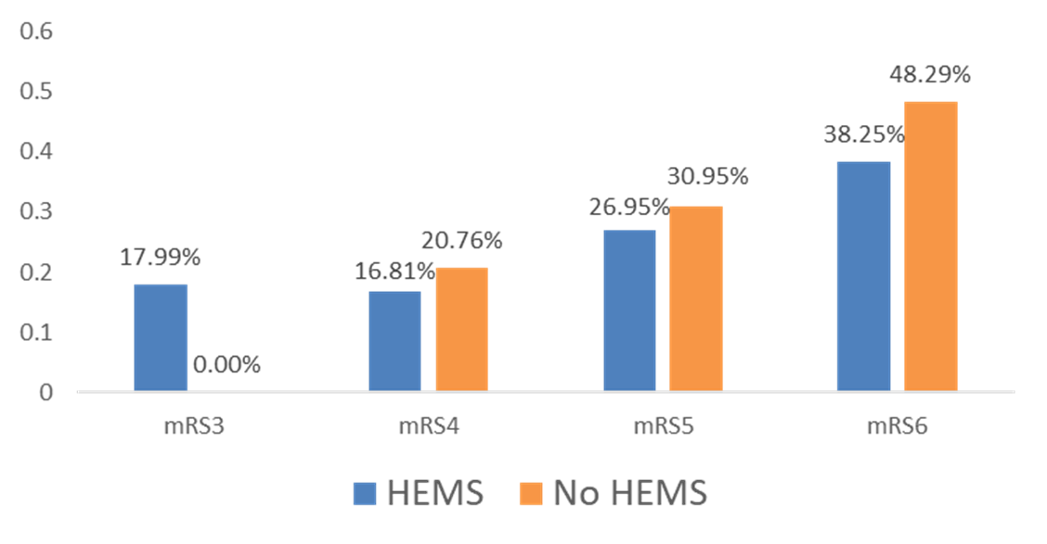
Results (4)
1) Increased share of deliveries by HEMS (20%) vs. current situation (4.9%)
An increased proportion of HEMS also achieved a better outcome.
In year 10, more patients remained in better health stages according mRS than in the comparator group.
A higher frequency of HEMS generated additional 0.764 QALYs or 9 months in perfect health.
A higher proportion of HEMS improved life expectancy by 1.164 LYs or 14 months.
mRS distribution in year 10 of scenario (2)
IPF - Institut für Pharmaökonomische Forschung
IPF - Institut für Pharmaökonomische Forschung
IPF - Institut für Pharmaökonomische Forschung
11
11
11

Slide 12
Conclusion
From the point of view of the Austrian healthcare system, a higher proportion of patients transported by helicopter to the Stroke Unit is associated with savings (€3,500 to €10,191 per patient).
An increase in helicopter use to 20% of all hospital admissions in stroke patients leads to a savings potential of € 43.3 million.
On the outcome side 9,100 life-years could be gained. This corresponds to 2,980 quality-adjusted life-years (QALYs).
1 € spend in HEMS results in savings of 15.9 € in the health-care and social system
Thank you for your attention!
IPF - Institut für Pharmaökonomische Forschung
IPF - Institut für Pharmaökonomische Forschung
IPF - Institut für Pharmaökonomische Forschung
IPF - Institut für Pharmaökonomische Forschung
12
12
12
12

